Slide 1
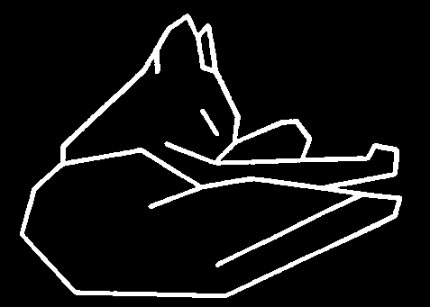
Introduction
Computer Vision
Part I
Feature Extraction (2)
Edge Detection
Zhigang Zhu, City College of New York zhu@cs.ccny.cuny.edu

Slide 2
Introduction
Computer Vision
Part I
Feature Extraction (2)
Edge Detection
Zhigang Zhu, City College of New York zhu@cs.ccny.cuny.edu

Slide 3
Edge Detection
What’s an edge?
“He was sitting on the Edge of his seat.”
“She paints with a hard Edge.”
“I almost ran off the Edge of the road.”
“She was standing by the Edge of the woods.”
“Film negatives should only be handled by their Edges.”
“We are on the Edge of tomorrow.”
“He likes to live life on the Edge.”
“She is feeling rather Edgy.”
The definition of Edge is not always clear.
In Computer Vision, Edge is usually related to a discontinuity within a local set of pixels.

Slide 4
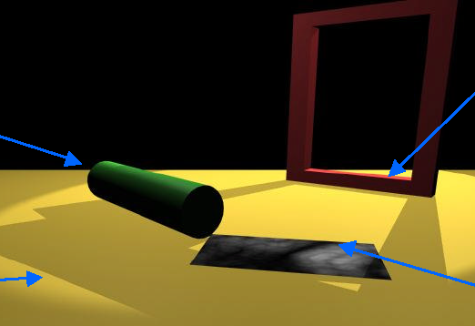
Discontinuities
B
A
C
D
A: Depth discontinuity: abrupt depth change in the world
B: Surface normal discontinuity: change in surface orientation
C: Illumination discontinuity: shadows, lighting changes
D: Reflectance discontinuity: surface properties, markings

Slide 5

Illusory Edges
Kanizsa Triangles
Illusory edges will not be detectable by the algorithms that we will discuss
No change in image irradiance - no image processing algorithm can directly address these situations
Computer vision can deal with these sorts of things by drawing on information external to the image (perceptual grouping techniques)

Slide 6
Another One

Slide 7
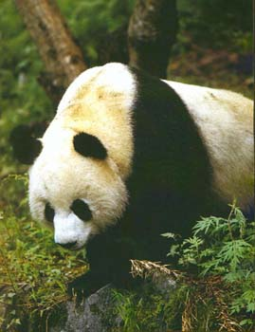
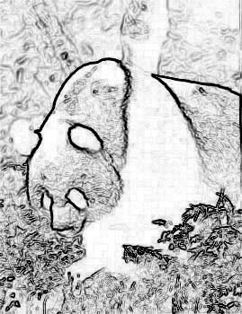
Goal
Devise computational algorithms for the extraction of significant edges from the image.
What is meant by significant is unclear.
Partly defined by the context in which the edge detector is being applied

Slide 8
Edgels
Define a local edge or edgel to be a rapid change in the image function over a small area
implies that edgels should be detectable over a local neighborhood
Edgels are NOT contours, boundaries, or lines
edgels may lend support to the existence of those structures
these structures are typically constructed from edgels
Edgels have properties
Orientation
Magnitude
Position

Slide 9
Outline
First order edge detectors (lecture - required)
Mathematics
1x2, Roberts, Sobel, Prewitt
Canny edge detector (after-class reading)
Second order edge detector (after-class reading)
Laplacian, LOG / DOG
Hough Transform – detect by voting
Lines
Circles
Other shapes

Slide 10
Locating Edgels
Rapid change in image => high local gradient => differentiation
f(x) = step edge
1st Derivative f ’(x)
maximum
2nd Derivative -f ’’(x)
zero crossing

Slide 11
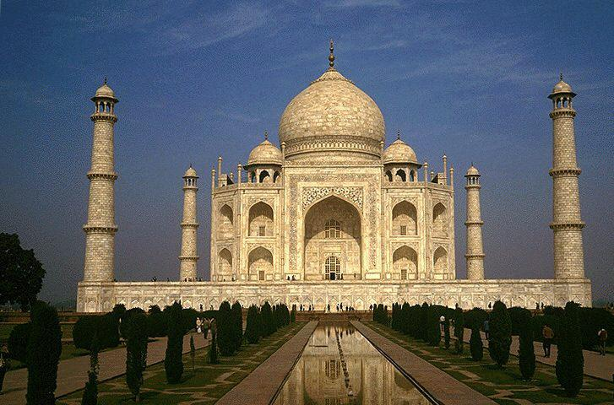
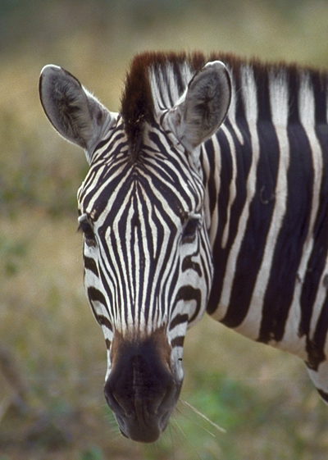
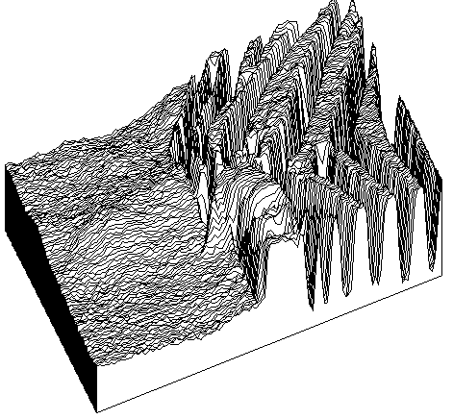
Reality

Slide 12



Properties of an Edge
Original
Orientation
Orientation
Position
Magnitude

Slide 13
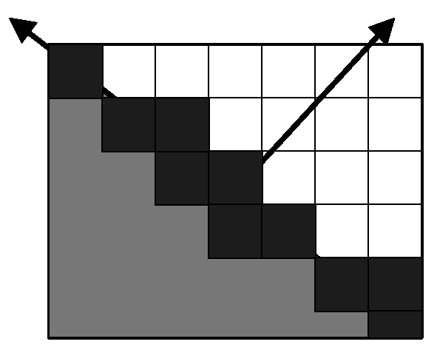
Quantitative Edge Descriptors
Edge Orientation
Edge Normal - unit vector in the direction of maximum intensity change (maximum intensity gradient)
Edge Direction - unit vector perpendicular to the edge normal
Edge Position or Center
image position at which edge is located (usually saved as binary image)
Edge Strength / Magnitude
related to local contrast or gradient - how rapid is the intensity variation across the edge along the edge normal.

Slide 14
Edge Degradation in Noise
Increasing noise
Ideal step edge
Step edge + noise

Slide 15
Real Image

Slide 16
Edge Detection: Typical
Noise Smoothing
Suppress as much noise as possible while retaining ‘true’ edges
In the absence of other information, assume ‘white’ noise with a Gaussian distribution
Edge Enhancement
Design a filter that responds to edges; filter output high are edge pixels and low elsewhere
Edge Localization
Determine which edge pixels should be discarded as noise and which should be retained
thin wide edges to 1-pixel width (nonmaximum suppression)
establish minimum value to declare a local maximum from edge filter to be an edge (thresholding)

Slide 17
Edge Detection Methods
1st Derivative Estimate
Gradient edge detection
Compass edge detection
Canny edge detector (*)
2nd Derivative Estimate
Laplacian
Difference of Gaussians
Parametric Edge Models (*)

Slide 18
Gradient Methods
F(x)
Edge= sharp variation
x
F’(x)
Large first derivative
x

Slide 19
Gradient of a Function
Assume f is a continuous function in (x,y). Then
are the rates of change of the function f in the x and y directions, respectively.
The vector (Δ_{x}, Δ_{y}) is called the gradient of f.
This vector has a magnitude:
and an orientation:
θ is the direction of the maximum change in f.
S is the size of that change.
Δ_{y}
θ = tan⁻¹ ( )
Δ_{x}

Slide 20
Geometric Interpretation
But
I(i,j) is not a continuous function.
Therefore
look for discrete approximations to the gradient.

Slide 21
Discrete Approximations
df(x)
f(x + Δx) - f(x)
f(x)
= lim
dx
Δx
Δx 0
df(x)
f(x) - f(x-1)
dx
≅
1
x-1
x
Convolve with -1 1

Slide 22
In Two Dimensions
Discrete image function I
Derivatives Differences
-1
Δ_{j}I =
-1 1
Δ_{i}I =
1

Slide 23
1x2 Example
1x2 Vertical
Combined
1x2 Horizontal

Slide 24
Smoothing and Edge Detection
Derivatives are 'noisy' operations
edges are a high spatial frequency phenomenon
edge detectors are sensitive to and accent noise
Averaging reduces noise
spatial averages can be computed using masks
Combine smoothing with edge detection.

Slide 25
Effect of Blurring
Original
Orig+1 Iter
Orig+2 Iter
Image
Edges
Thresholded
Edges

Slide 26
Combining the Two
Applying this mask is equivalent to taking the difference of averages on either side of the central pixel.

Slide 27
Many Different Kernels
Variables
Size of kernel
Pattern of weights
1x2 Operator (we’ve already seen this one
-1
Δ_{j}I =
-1 1
Δ_{i}I =
1

Slide 28
Roberts Cross Operator
Does not return any information about the orientation of the edge
S =
[ I(x, y) - I(x+1, y+1) ]² + [ I(x, y+1) - I(x+1, y) ]²
or
S =
| I(x, y) - I(x+1, y+1) | + | I(x, y+1) - I(x+1, y) |
1 0
0 -1
0 1
-1 0
+

Slide 29
Sobel Operator
-1 -2 -1
0 0 0
1 2 1
-1 0 1
-2 0 2
-1 0 1
S₁=
S₂ =
Edge Magnitude =
2
2
S₁ + S₂
S₁
Edge Direction =
tan⁻¹
S₂
Notes:
S1, S2 represent response to the kernels. Not the kernel themselves

Slide 30
Anatomy of the Sobel
1/4
+
Sobel kernel is separable!
1/4
Averaging done parallel to edge
Notes:
Explain how this is done.

Slide 31
Prewitt Operator
-1 -1 -1
0 0 0
1 1 1
-1 0 1
-1 0 1
-1 0 1
P₁=
P₂ =
Edge Magnitude =
2
2
P₁ + P₂
P₁
Edge Direction =
tan⁻¹
P₂
Notes:
P1, P2 represent response, not the kernels

Slide 32
Large Masks
What happens as the mask size increases?

Slide 33
Large Kernels
7x7 Horizontal Edges only
13x13 Horizontal Edges only

Slide 34
Compass Masks
Use eight masks aligned with the usual compass directions
Select largest response (magnitude)
Orientation is the direction associated with the largest response

Slide 35
Many Different Kernels
Frei & Chen

Slide 36
Robinson Compass Masks
-1 0 1
-2 0 2
-1 0 1
0 1 2
-1 0 1
-2 -1 0
1 2 1
0 0 0
-1 -2 -1
2 1 0
1 0 -1
0 -1 -2
1 0 -1
2 0 -2
1 0 -1
0 -1 -2
1 0 -1
2 1 0
-1 -2 -1
0 0 0
1 2 1
-2 -1 0
-1 0 1
0 1 2

Slide 37
Analysis of Edge Kernels
Analysis based on a step edge inclined at an angle θ (relative to y-axis) through center of window.
Robinson/Sobel: true edge contrast less than 1.6% different from that computed by the operator.
Error in edge direction
Robinson/Sobel: less than 1.5 degrees error
Prewitt: less than 7.5 degrees error
Summary
Typically, 3 x 3 gradient operators perform better than 2 x 2.
Prewitt2 and Sobel perform better than any of the other 3x3 gradient estimation operators.
In low signal to noise ratio situations, gradient estimation operators of size larger than 3 x 3 have improved performance.
In large masks, weighting by distance from the central pixel is beneficial.

Slide 38
Prewitt Example
Santa Fe Mission
Prewitt Horizontal and Vertical Edges Combined

Slide 39
Edge Thresholding
Global approach
Edge Histogram
64
128
T=128
T=64
See Haralick paper for thresholding based on statistical significance tests.

Slide 40
Reading and Homework
- Go through slides 40-71 after class
- Reading: Lecture notes on feature extraction
- Homework 2: Due after two weeks
You may try different filters in Matlab, but do your homework
by your programming … …

Slide 41
Canny Edge Detector
Probably most widely used
LF. Canny, "A computational approach to edge detection", IEEE Trans. Pattern Anal. Machine Intelligence (PAMI), vol. PAMI vii-g, pp. 679-697, 1986.
Based on a set of criteria that should be satisfied by an edge detector:
Good detection. There should be a minimum number of false negatives and false positives.
Good localization. The edge location must be reported as close as possible to the correct position.
Only one response to a single edge.
Cost function which could be optimized using variational methods

Slide 42
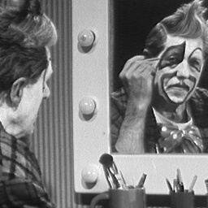
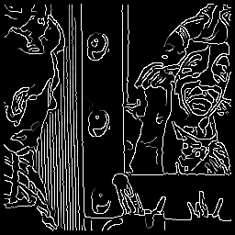
Canny Results
σ=1, T2=255, T1=1
I = imread(‘image file name’);
BW1 = edge(I,'sobel');
BW2 = edge(I,'canny');
imshow(BW1)
figure, imshow(BW2)
‘Y’ or ‘T’ junction problem with Canny operator

Slide 43
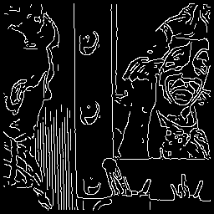
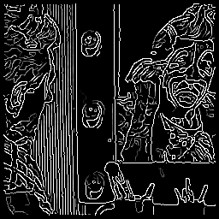
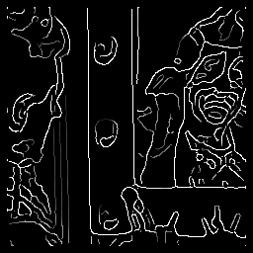
Canny Results
σ=1, T2=255, T1=220
σ=1, T2=128, T1=1
σ=2, T2=128, T1=1
M. Heath, S. Sarkar, T. Sanocki, and K.W. Bowyer, "A Robust Visual Method for Assessing the Relative Performance of Edge-Detection Algorithms" IEEE Transactions on Pattern Analysis and Machine Intelligence, Vol. 19, No. 12, December 1997, pp. 1338-1359.
http://marathon.csee.usf.edu/edge/edge_detection.html

Slide 44
Second derivatives…

Slide 45
Edges from Second Derivatives
Digital gradient operators estimate the first derivative of the image function in two or more directions.
f(x) = step edge
1st Derivative f’(x)
maximum
GRADIENT
METHODS
2nd Derivative f’’(x)
zero crossing

Slide 46
Second Derivatives
Second derivative = rate of change of first derivative.
Maxima of first derivative = zero crossings of second derivative.
For a discrete function, derivatives can be approximated by differencing.
Consider the one dimensional case:
2
Δ f(i) = Δ f(i+1) - Δ f(i)
= f(i+1) - 2 f(i) + f(i-1)
Mask:

Slide 47
Laplacian Operator
Now consider a two-dimensional function f(x,y).
The second partials of f(x,y) are not isotropic.
Can be shown that the smallest possible isotropic second derivative operator is the Laplacian:
Two-dimensional discrete approximation is:

Slide 48
Example Laplacian Kernels
5X5
9X9
Note that these are not the optimal approximations to the Laplacian of the sizes shown.

Slide 49
Example Application
5x5 Laplacian Filter
9x9 Laplacian Filter

Slide 50

Detailed View of Results

Slide 51
Interpretation of the Laplacian
Consider the definition of the discrete Laplacian:
Rewrite as:
Factor out -5 to get:
Laplacian can be obtained, up to the constant -5, by subtracting the average value around a point (i,j) from the image value at the point (i,j)!
What window and what averaging function?
looks like a window sum

Slide 52
Enhancement using the Laplacian
The Laplacian can be used to enhance images:
If (i,j) is in the middle of a flat region or long ramp: I-∇²I = I
If (i,j) is at low end of ramp or edge: I-∇²I < I
If (i,j) is at high end of ramp or edge: I-∇²I > I
Effect is one of deblurring the image

Slide 53
Laplacian Enhancement
Blurred Original
3x3 Laplacian Enhanced

Slide 54
Noise
Second derivative, like first derivative, enhances noise
Combine second derivative operator with a smoothing operator.
Questions:
Nature of optimal smoothing filter.
How to detect intensity changes at a given scale.
How to combine information across multiple scales.
Smoothing operator should be
'tunable' in what it leaves behind
smooth and localized in image space.
One operator which satisfies these two constraints is the Gaussian:

Slide 55
2D Gaussian Distribution
The two-dimensional Gaussian distribution is defined by:
From this distribution, can generate smoothing masks whose width depends upon σ:

Slide 56
σ Defines Kernel ‘Width’
σ² = .25
σ² = 1.0
σ² = 4.0

Slide 57
Creating Gaussian Kernels
The mask weights are evaluated from the Gaussian distribution:
This can be rewritten as:
This can now be evaluated over a window of size nxn to obtain a kernel in which the (0,0) value is 1.
k is a scaling constant
i² + j²
W(i,j) = k * exp (- )
2 σ²
W(i,j)
i² + j²
= exp (- )
k
2 σ²

Slide 58
Example
Choose σ = 2. and n = 7, then:
2
j
-3
-2
-1
0
1
2
3
-3
-2
-1
i
0
1
2
3

Slide 59
Example
Plot of Weight Values
7x7 Gaussian Filter

Slide 60
Kernel Application
7x7 Gaussian Kernel
15x15 Gaussian Kernel

Slide 61
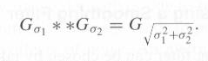
Why Gaussian for Smoothing
Gaussian is not the only choice, but it has a number of important properties
If we convolve a Gaussian with another Gaussian, the result is a Gaussian
This is called linear scale space
Efficiency: separable
Central limit theorem

Slide 62
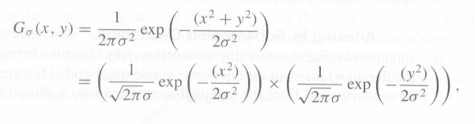
Why Gaussian for Smoothing
Gaussian is separable

Slide 63
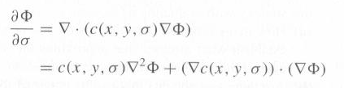
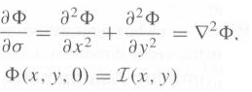
Why Gaussian for Smoothing – cont.
Gaussian is the solution to the diffusion equation
We can extend it to non-linear smoothing

Slide 64
∇²G Filter
Marr and Hildreth approach:
1. Apply Gaussian smoothing using σ's of increasing size:
2. Take the Laplacian of the resulting images:
3. Look for zero crossings.
Second expression can be written as:
Thus, can take Laplacian of the Gaussian and use that as the operator.

Slide 65
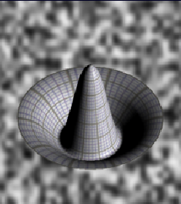
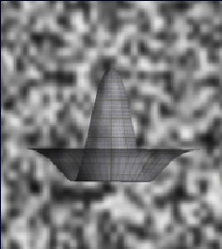
Mexican Hat Filter
Laplacian of the Gaussian
∇²G is a circularly symmetric operator.
Also called the hat or Mexican-hat operator.

Slide 66
σ² Controls Size
σ² = 0.5
σ² = 1.0
σ² = 2.0

Slide 67
Kernels
17 x 17
5x5
Remember the center surround cells in the human system?

Slide 68
Example
13x13 Kernel

Slide 69
Example
13 x 13 Hat Filter
Thesholded Positive
Thesholded Negative
Zero Crossings

Slide 70
Scale Space
17x17 LoG Filter
Thresholded Positive
Thresholded Negative
Zero Crossings

Slide 71
Scale Space
σ² = 2
σ² = 2
σ² =2 2
σ² = 4

Slide 72
Multi-Resolution Scale Space
Observations:
For sufficiently different σ 's, the zero crossings will be unrelated unless there is 'something going on' in the image.
If there are coincident zero crossings in two or more successive zero crossing images, then there is sufficient evidence for an edge in the image.
If the coincident zero crossings disappear as σ becomes larger, then either:
two or more local intensity changes are being averaged together, or
two independent phenomena are operating to produce intensity changes in the same region of the image but at different scales.
Use these ideas to produce a 'first-pass' approach to edge detection using multi-resolution zero crossing data.
Never completely worked out
See Tony Lindbergh’s thesis and papers

Slide 73
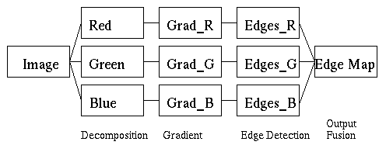
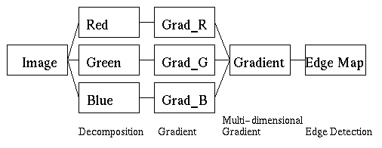
Color Edge Detection
Typical Approaches
Fusion of results on R, G, B separately
Multi-dimensional gradient methods
Vector methods
Color signatures: Stanford (Rubner and Thomasi)

Slide 74
Hierarchical Feature Extraction
Most features are extracted by combining a small set of primitive features (edges, corners, regions)
Grouping: which edges/corners/curves form a group?
perceptual organization at the intermediate-level of vision
Model Fitting: what structure best describes the group?
Consider a slightly simpler problem…..

Slide 75
From Edgels to Lines
Given local edge elements:
Can we organize these into more 'complete' structures, such as straight lines?
Group edge points into lines?
Consider a fairly simple technique...

Slide 76
Edgels to Lines
Given a set of local edge elements
With or without orientation information
How can we extract longer straight lines?
General idea:
Find an alternative space in which lines map to points
Each edge element 'votes' for the straight line which it may be a part of.
Points receiving a high number of votes might correspond to actual straight lines in the image.
The idea behind the Hough transform is that a change in representation converts a point grouping problem into a peak detection problem

Slide 77
Edgels to Lines
Consider two (edge) points, P(x,y) and P’(x’,y’) in image space:
The set of all lines through P=(x,y) is y=mx + b, for appropriate choices of m and b.
Similarly for P’
But this is also the equation of a line in (m,b) space, or parameter space.
y
L
P '
P
x

Slide 78
Parameter Space
The intersection represents the parameters of the equation of a line y=mx+b going through both (x,y) and (x',y').
The more colinear edgels there are in the image, the more lines will intersect in parameter space
Leads directly to an algorithm
b
L
x,y; x',y' are fixed
1
b = -mx+y
L
2
b’ = -m’x'+y'
m
(m
,b
)

Slide 79
General Idea
General Idea:
The Hough space (m,b) is a representation of every possible line segment in the plane
Make the Hough space (m and b) discrete
Let every edge point in the image plane ‘vote for’ any line it might belong to.

Slide 80
Hough Transform
Line Detection Algorithm: Hough Transform
Quantize b and m into appropriate 'buckets'.
Need to decide what’s ‘appropriate’
Create accumulator array H(m,b), all of whose elements are initially zero.
For each point (i,j) in the edge image for which the edge magnitude is above a specific threshold, increment all points in H(m,b) for all discrete values of m and b satisfying b = -mj+i.
Note that H is a two dimensional histogram
Local maxima in H corresponds to colinear edge points in the edge image.

Slide 81
Quantized Parameter Space
Quantization
b
single votes
two votes
m
The problem of line detection in image space has been transformed into the problem of cluster
detection in parameter space

Slide 82
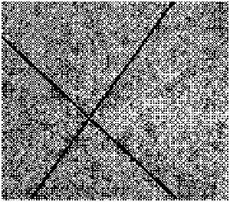
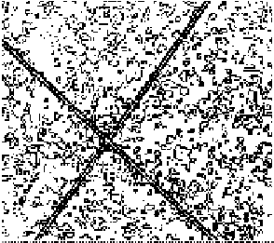
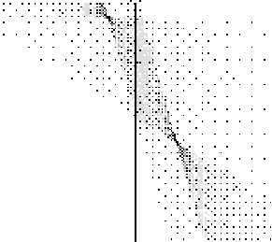
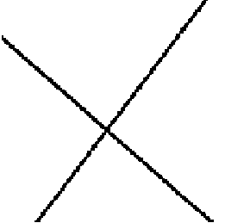
Example
The problem of line detection in image space has been transformed into the problem of cluster detection in parameter space
Image
Edges
Accumulator
Array
Result

Slide 83
Problems
Vertical lines have infinite slopes
difficult to quantize m to take this into account.
Use alternative parameterization of a line
polar coordinate representation
y
r = x cos θ + y sin θ
r
2
θ
r
2
1
θ
1
x

Slide 84
Why?
(r,θ) is an efficient representation:
Small: only two parameters (like y=mx+b)
Finite: 0 ≤ r ≤ √(row²+col²), 0 ≤ θ ≤ 2π
Unique: only one representation per line

Slide 85
Alternate Representation
Curve in (r,θ) space is now a sinusoid
but the algorithm remains valid.
r
r
1
=
x
1
cos
θ
+
y
1
sin
θ
r
2
=
x
2
cos
θ
+
y
2
sin
θ
2
θ
π

Slide 86
Example
y
P
2
P
P = (4, 4)
1
1
r
P = (-3, 5)
2
θ
x
(
r,
θ
)

Slide 87
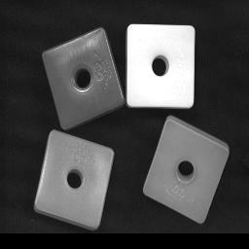
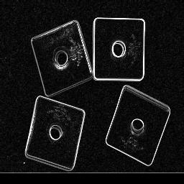
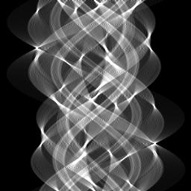
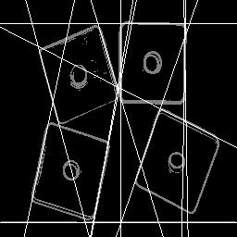
Real Example
Image
Edges
Accumulator
Array
Result

Slide 88

Modifications
Note that this technique only uses the fact that an edge exists at point (i,j).
What about the orientation of the edge?
More constraints!
Use estimate of edge orientation as θ.
Each edgel now maps to a point in Hough space.
Image
The three edgels have same (r, θ)
Origin is arbitrary

Slide 89
Gradient Data
Colinear edges in Cartesian coordinate space now form point clusters in (m,b) parameter space.
L
2
L
1
E
1
L
3
E
2
E
3
m

Slide 90
Gradient Data
‘Average’ point in Hough Space:
Leads to an ‘average’ line in image space:
m

Slide 91
Post Hough
Image space localization is lost:
Consequently, we still need to do some image space manipulations, e.g., something like an edge 'connected components' algorithm.
Heikki Kälviäinen, Petri Hirvonen, L. Xu and Erkki Oja, “Probabilistic and nonprobabilistic Hough Transforms: Overview and comparisons”, Image and vision computing, Volume 13, Number 4, pp. 239-252, May 1995.
both sets contribute to
the same Hough maxima.

Slide 92
Hough Fitting
Sort the edges in one Hough cluster
rotate edge points according to θ
sort them by (rotated) x coordinate
Look for Gaps
have the user provide a “max gap” threshold
if two edges (in the sorted list) are more than max gap apart, break the line into segments
if there are enough edges in a given segment, fit a straight line to the points

Slide 93
Generalizations
Hough technique generalizes to any parameterized curve:
Success of technique depends upon the quantization of the parameters:
too coarse: maxima 'pushed' together
too fine: peaks less defined
Note that exponential growth in the dimensions of the accumulator array with the the number of curve parameters restricts its practical application to curves with few parameters
f(x,a) = 0
parameter vector (axes in Hough space)

Slide 94
Example: Finding a Circle
Circles have three parameters
Center (a,b)
Radius r
Circle f(x,y,r) = (x-a)²+(y-b)²-r² = 0
Task:
Given an edge point at (x,y) in the image, where could the center of the circle be?
Find the center of a circle with known radius r given an edge image with no gradient direction information (edge location only)

Slide 95
Finding a Circle
Image
Parameter space (a,b)
fixed (i,j)
(i-a)²+(j-b)²-r² = 0
Circle Center(lots of votes!)
Parameter space (a,b)
Parameter space (a,b)

Slide 96
Finding Circles
If we don’t know r, accumulator array is 3-dimensional
If edge directions are known, computational complexity if reduced
Suppose there is a known error limit on the edge direction (say +/- 10^{o)} - how does this affect the search?
Hough can be extended in many ways….see, for example:
Ballard, D. H. Generalizing the Hough Transform to Detect Arbitrary Shapes, Pattern Recognition 13:111-122, 1981.
Illingworth, J. and J. Kittler, Survey of the Hough Transform, Computer Vision, Graphics, and Image Processing, 44(1):87-116, 1988
Notes:
We have an additional constraint :
2(x-a) dx + 2(y-b) dy = 0
(y-b) / (x-a) = = - dx/dy = Gy/Gx = tan (theta)
=> b= B(a,theta, x,y), b is a function of a at each point (x,y) with edge gradient orientation theta
=> Only search in (a, r) space

Slide 97
Next
Camera Models

